Slide 2
Introduction to Shader Programming
Notes:
Hello, and welcome to this session about how to write custom shaders in Unity.
This presentation is a mix of multiple books, projects and hours of research into the topic, the main goal is to provide a simple and quick overview of what programmable shaders are, what the goal of knowing how to work with them is and of course, how to get up and running in shader writing.
This is sometimes considered a difficult topic, however, it is not, and it is very fun to do!

Slide 3
Arturo Núñez Product Evangelist, Unity Technologies @ArturoNereu
Notes:
My name is Arturo Núñez, I work as a product evangelist for the Latin American region. I love games and computer graphics, in fact CG is probably my favorite part of game development. And today I want to share with you a bit of that passion.

Slide 4
Shader
A set of instructions that runs on the GPU
Notes:
Before we start, if there is one thing that we want to know today is that a shader in the context of Unity, is simply a set of instructions that runs on the GPU (Graphics Processing Unit).

Slide 5
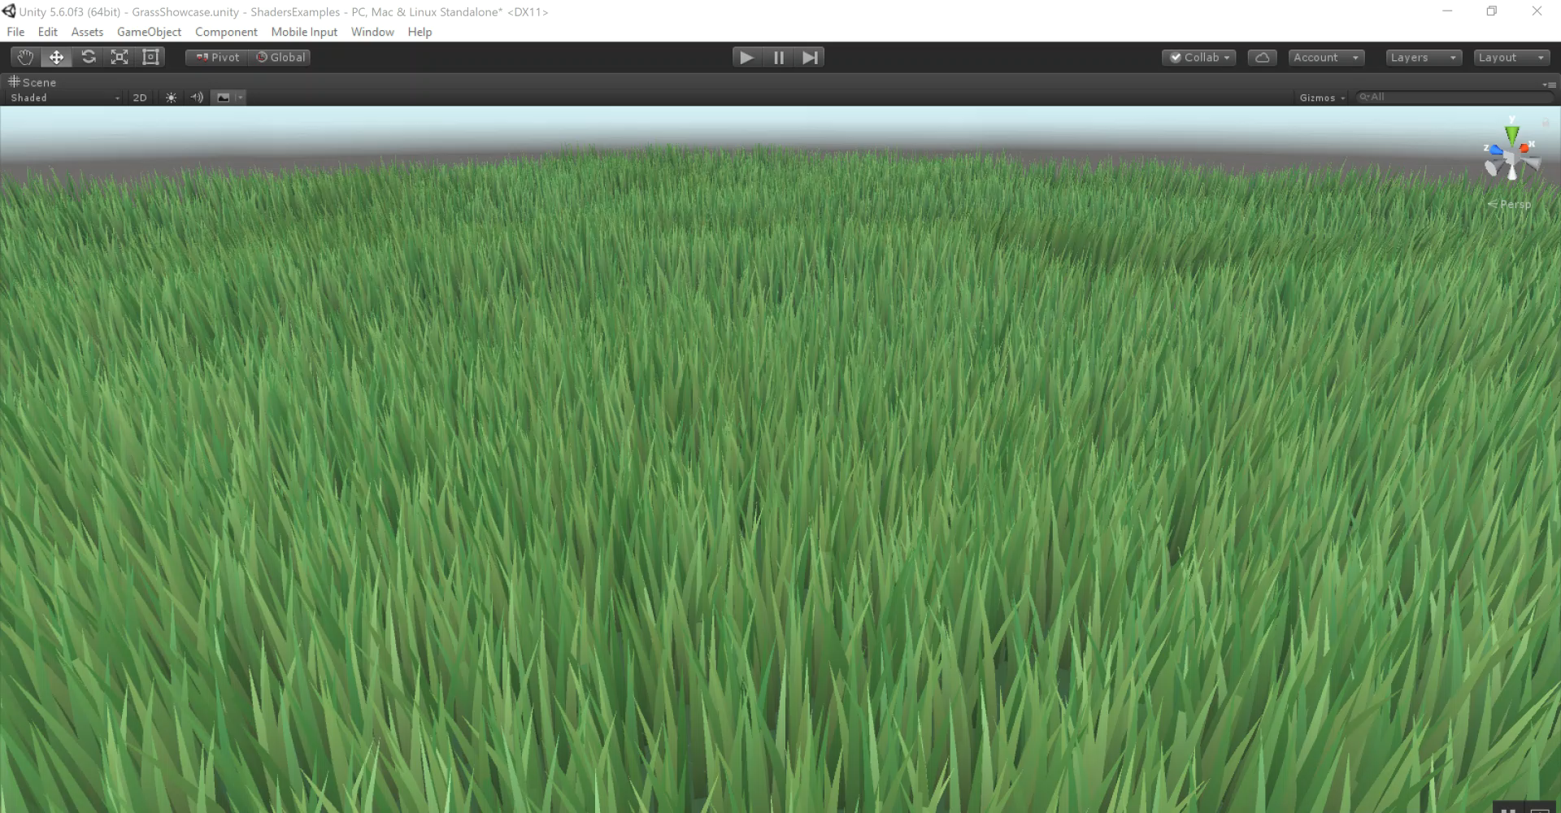
DirectX 11 Grass Shader
Notes:
Vertex Shader Example: Animated Grass Shader

Slide 6
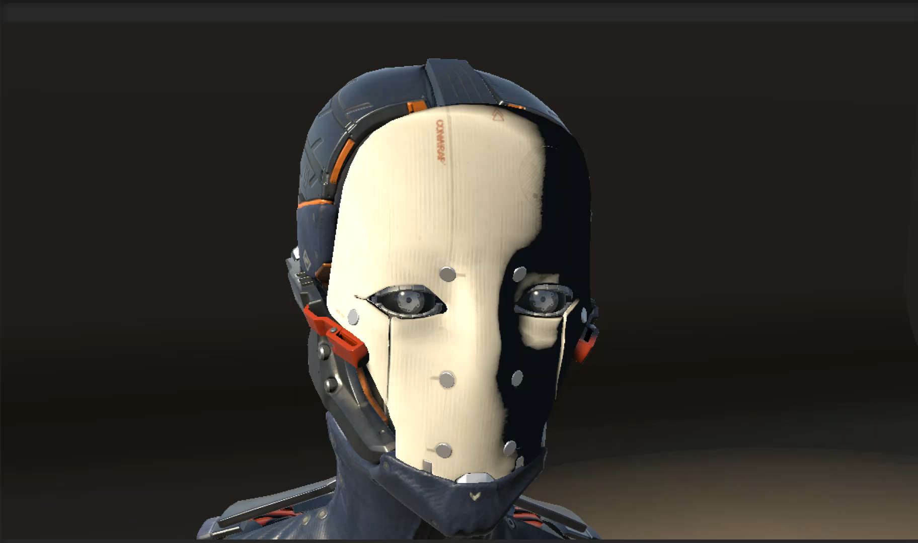
Amplify Shader Editor
Notes:
Pixel Shader Example: Dissolve

Slide 7
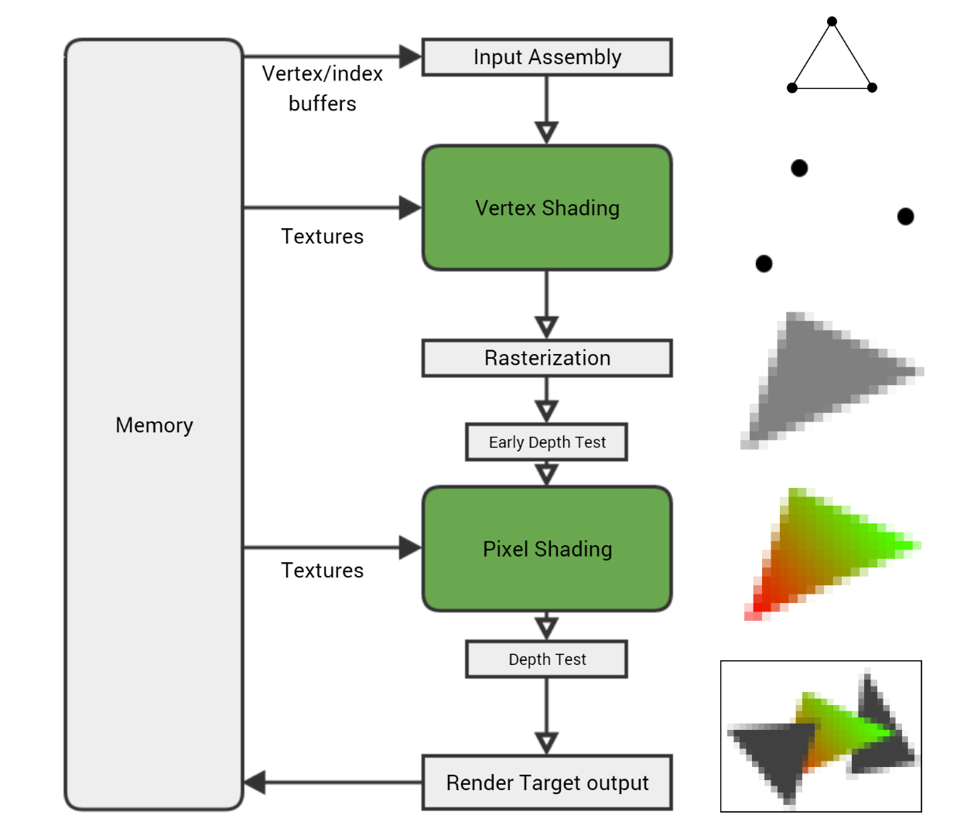
The Rendering Pipeline
http://fragmentbuffer.com/gpu-performance-for-game-artists/
Notes:
The process of pushing pixels to our phone’s screen, VR headsets or tvs is called rendering. In our case we focus on real time render, which basically means, our program will be generating many images per second (usually 30, 60 or 90).
Then, the process of transforming a 3D scene (even if it’s a 2D game) is very complex, however when we talk about shader programming in Unity we simplify it a bit and focus mainly in the Vertex and Fragment programs in a Shader.
TODO: Replace the graphic or credit it correctly.
The Rendering Pipeline
Credit here: http://fragmentbuffer.com/gpu-performance-for-game-artists/

Slide 8
Types of Shaders
Vertex Shaders
Fragment Shaders
Surface Shaders
More…
Notes:
There are multiples types of shaders, but for now we will focus on the three basic shader programs available to us in Unity. Which are the vertex shaders, the fragment or pixel shaders and the Surface shaders.
There are more type of shaders, but for an introduction presentation we will not talk about them.

Slide 9
The Vertex Shader
Input
Multiple vertices: position, normal, color
Output
New Position
Other Information
Notes:
We will switch to Unity here, but what is important to know from the vertex shader is that any transformatin to the mesh’s vértices will happen here. If we anímate the position, color, etc of a vertex, it needs to happen here.
The vertex program will run on every vertex we have in our mesh.
The result will be sent to the rasterizer, to tell if that fragment will end up as a pixel.

Slide 10
The Fragment Shader
Input
Fragments to become Pixels
Output
Color of Pixel
Alpha of Pixel
Notes:
We will explain this with a Unity demo, however it’s important to know that:
- The fragment(or pixel shader) is the program that receives information from the vertex program and the result will be a color to be rendered on screen. Or on an object’s Surface.

Slide 11
The Surface Shader
Auto-generated code approach.
Useful to interact with lighting models in a simple way.
Notes:
Unity Demo here.
You define a “surface function” that takes any UVs or data you need as input, and fills in output structure SurfaceOutput. SurfaceOutput basically describes properties of the surface (it’s albedo color, normal, emission, specularity etc.). You write this code in HLSL.
Surface Shader compiler then figures out what inputs are needed, what outputs are filled and so on, and generates actual vertex&pixel shaders, as well as rendering passes to handle forward and deferred rendering.

Slide 12
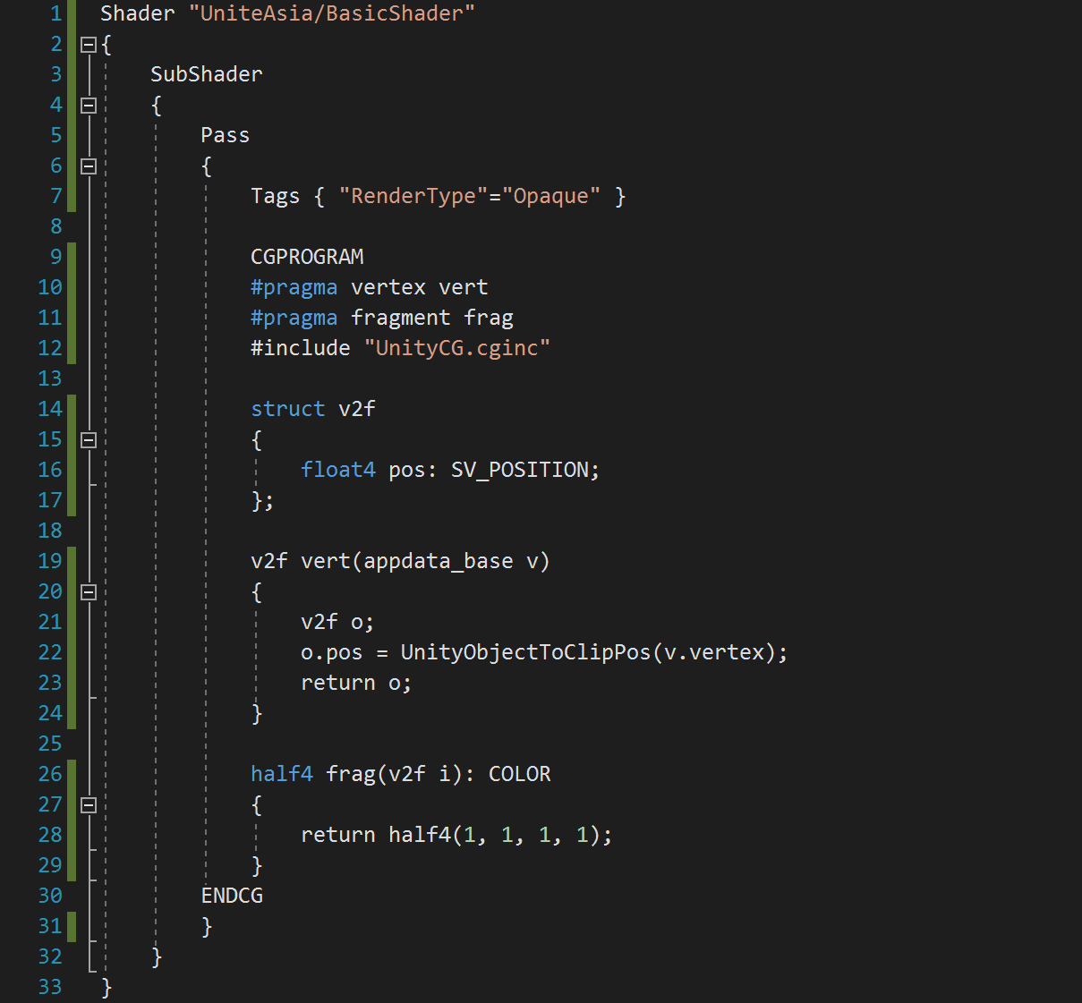
A Basic Shader

Slide 13
We program our shaders using…
CG (C for Graphics)
ShaderLab
Notes:
When programming shaders in Unity, we need to remember that we will be dealing with two programming languages;
One, is CG, invented by Nvidia and also known as C for Graphics, it’s syntax is similar to the one from the C language. And here is where we will be doing all the heavy weightlifting, calculations, etc.
On the other hand, we have ShaderLab, which is a wrapper that allows our shader program to communicate with the Unity engine, so we can modify the values that will be send to the shader.

Slide 14
CG
Similar to the “C” language.
Precision:
float
half
fixed
Variables with 1, 2, 3 or 4 values
float a = 10.5;
float2 uv = float2(0.5, 0.5);
float3 normal = float3(0.2, 0.5, 0.3);
float4 color = float4(1, 1, 0, 1);
Notes:
Here, I mention the features of CG:
It’s very similar to the C language, which means, there are no new things to learn if you have programmed before in c-like languages.
There are three type of precisions to use with the numbers, depending on how precise we want the computation to be, we should select one over the other.
We can store variables in different structures. Since we deal mostly with colors, vértices, etc. We deal with lot’s of vectors.

Slide 15
CG
We can access the values using “swizzling”:
float3 c = color.rgb;
foat3 c = color.xyz;
float2 c = color.yx;
We operate in Parallel:
float3 a = float3(4.5, 2.2, 3.3);
float3 b = float3(2.5, 3.1, 1.4);
float3 c = a + b;
Notes:
- We can Access the values of our variables (vectors) in any order we want. This is called swizzling, and it’s very common to work with it when writing shaders.
- One powerfull feature that is hardwired into how GPU’s work is the fact that we can do operations in parallel, which leads to really fast results. In the example, we see that the sum we perform on the two float3 variables will be done in parallel on the GPU.

Slide 16
appdata_base
struct appdata_base
{
float4 vertex : POSITION; // The vertex position in model space.
float3 normal : NORMAL; // The vertex normal in model space.
float4 texcoord : TEXCOORD0; // The first UV coordinate.
};
Notes:
This is a basic built in struct that provides the basic information to the vertex shader.

Slide 17
appdata_full
struct appdata_full
{
float4 vertex : POSITION; // The vertex position in model space.
float3 normal : NORMAL; // The vertex normal in model space.
float4 texcoord : TEXCOORD0; // The first UV coordinate.
float4 texcoord1 : TEXCOORD1; // The second UV coordinate.
float4 tangent : TANGENT; // The tangent vector in Model Space.
float4 color : COLOR; // Per-vertex color
};
Notes:
This is a basic built in struct that provides the full information to the vertex shader.

Slide 18
SurfaceOutput
struct SurfaceOutput
{
half3 Albedo; //Just the diffuse color.
half3 Normal; //Tangent space normal, if written.
half3 Emission; //Emission value in 0..1 range.
half Specular; //Specular power in 0..1 range.
half Gloss; //Specular intensity.
half Alpha; //Alpha value for transparency.
};

Slide 19
References
Slides and demo Project:
https://github.com/ArturoNereu/ShaderProgramming_101
Shader Programming online course:
http://cvgshader.teachable.com/courses/shader-development-using-unity-5
Making Stuff Look Good in Videogames:
https://www.youtube.com/channel/UCEklP9iLcpExB8vp_fWQseg
Notes:
Here are the references to be shared with attendees. The key here is just the first link which is a link to the project we used during the session.

Slide 20
References
Alan Zucconi’s Shaders Tutorials:
http://www.alanzucconi.com/2015/06/10/a-gentle-introduction-to-shaders-in-unity3d/
Gerardo Horvilleur on Shaders (Spanish):
https://www.youtube.com/watch?v=vaiyuVlZuCk
Shadertoy:
http://shadertoy.com
Notes:
Here are the references to be shared with attendees. The key here is just the first link which is a link to the project we used during the session.

Slide 21
Q & A
Notes:
Q&A
Note for Translator: How do I say Q&A in Japanese?

Slide 22
おおきに !!
Notes:
Thank you! ありがとう

